Slide 1
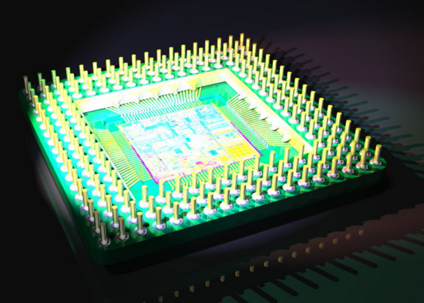
Microprocessor
Team Name: Deadlocks
Team Members
Name: Md. Omar Kaushru
Id: 1401020012
Name: Sajal Acharjee
Id: 1401020009
Batch: Spring 14
Semester : Spring 16
Course title: Digital Electronics & Pulse Technique
Faculty: Mr. Khaled Syfullah Fuad

Slide 2
Discussion Area
Definition
History
Main components
Knowledge one must have
Applications
Future prospect

Slide 3
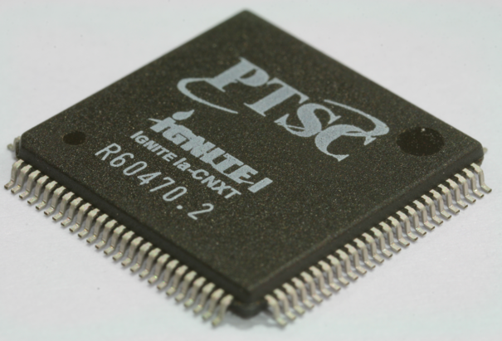
Definition of microprocessor
A microprocessor is a computer processor which incorporates the functions of a computer's central processing unit (CPU) on a single integrated circuit (IC), or at most a few integrated circuits. The microprocessor is a multipurpose, clock driven, register based, programmable electronic device which accepts digital or binary data as input, processes it according to instructions stored in its memory, and provides results as output. Microprocessors contain both combinational logic and sequential digital logic. Microprocessors operate on numbers and symbols represented in the binary numeral system.

Slide 4
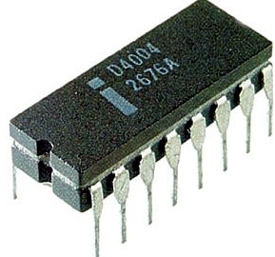
Definition of microprocessor (Continue)
A microprocessor, sometimes called a logic chip, is a computer processor on a microchip.
The microprocessor contains all, or most of, the central processing unit (CPU) functions and is the "engine" that goes into motion when we turn our computer on. It is designed to perform arithmetic and logical operations. Typical microprocessor operations include adding, subtracting, comparing two numbers, and fetching numbers from one area to another.
When your computer is turned on, the microprocessor gets the first instruction from the basic input/output system (BIOS) that comes with the computer as part of its memory. After that, either the BIOS, or the operating system that BIOS loads into computer memory, or an application program is "driving" the microprocessor, giving it instructions to perform.

Slide 5
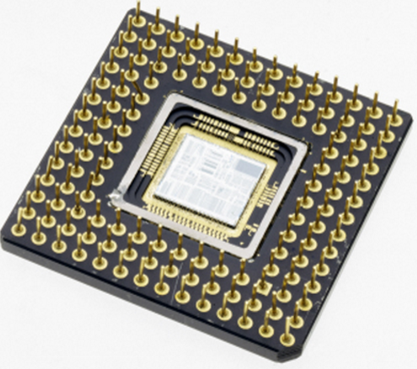
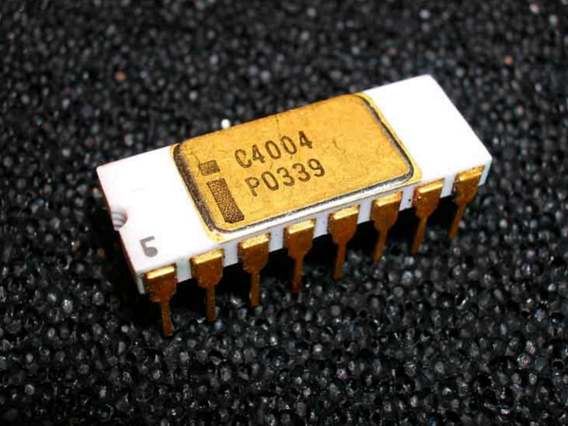
History of microprocessor
The first microprocessor was introduced in 1971 by Intel Corp.
The 4004 Microprocessor(4 bit):
At first 4004 microprocessor was introduced on November 15, 1971.
Performance:
1. Ran at a clock speed of 108KHz (108,000 cycles per second, or just over one-tenth a megahertz).
2. The 4004 contained 2,300 transistors and was built on a 10-micron process.( This means that each line, trace, or transistor could be spaced about 10 microns (millionths of a meter) apart.
3. Data was transferred 4 bits at a time and the maximum addressable memory was only 640 bytes.
4. The 4004 was designed for use in a calculator but proved to be useful for many other functions because of its inherent programmability. For example, the 4004 was used in traffic light controllers, blood analyzers, and even in the NASA Pioneer 10 deep space probe!

Slide 6
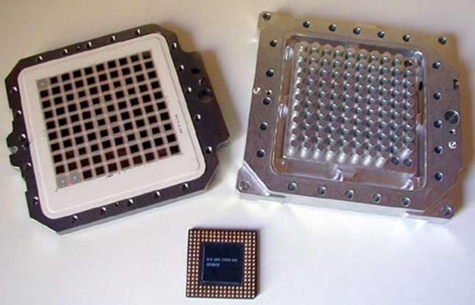
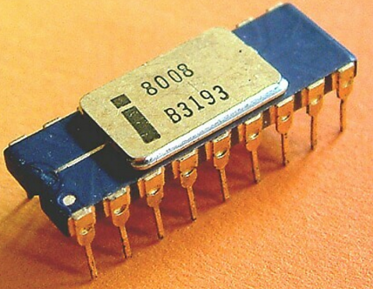
History of microprocessor (Continue)
The 8008 Microprocessor(8 bit)
In April 1972, Intel released the 8008 processor.
Performance:
1. Ran at a clock speed of 200KHz (0.2MHz).
2. The 8008 processor contained 3,500 transistors and was built on the same 10-micron process as the previous processor.
3. It had an 8-bit data bus.( which meant it could move data 8 bits at a time—twice as much as the previous chip.)
4. It could also address more memory, up to 16KB.

Slide 7
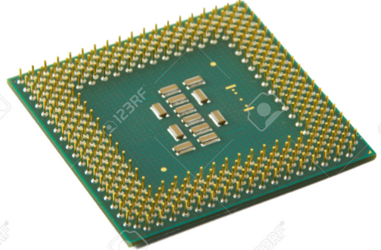
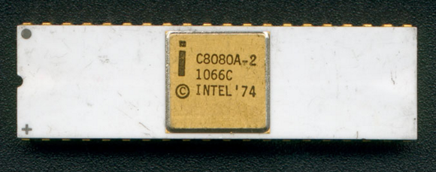
History of microprocessor (Continue)
The 8080 Microprocessor(8 bit)::
In April 1974, The 8080 microprocessor was released.
Performance:
1. Running at a clock rate of 2MHz.
2. Due mostly to the faster clock rate.
3. The 8080 chip contained 6,000 transistors and was built on a 6-micron process.
4. Similar to the previous chip, the 8080 had an 8-bit data bus, so it could transfer 8 bits of data at a time.
5. The 8080 could address up to 64KB of memory, significantly more than the previous chip.
N.B: In the next different version of 8080 processor was invented.

Slide 8
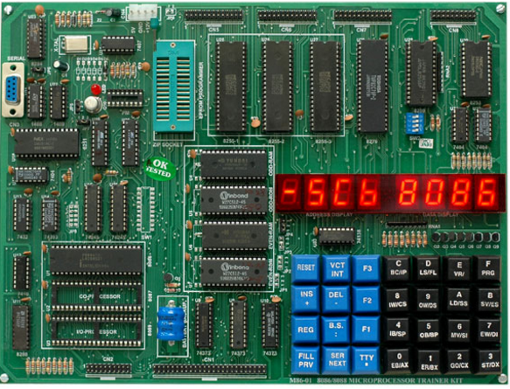
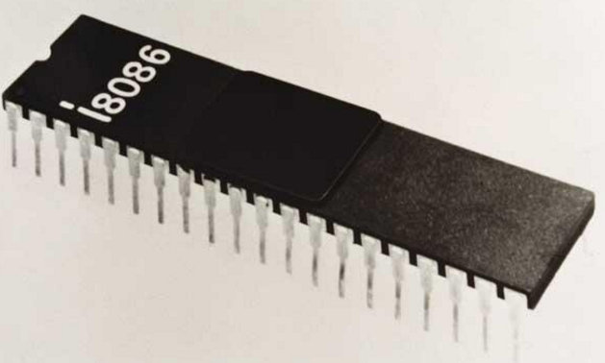
History of microprocessor (Continue)
The 8086 Microprocessor(16 bit):
Intel introduced the 8086 in June 1978.
Performance:
The 8086 chip brought with it the original x86 instruction set that is still present in current x86-compatible chips such as the Pentium 4.
1. The 8086 was a full 16-bit design with 16-bit internal registers and a 16-bit data bus.
2. The 8086 contained 29,000 transistors and initially ran at up to 5MHz.
3. The chip also used 20-bit addressing, so it could directly address up to 1MB of memory.

Slide 9
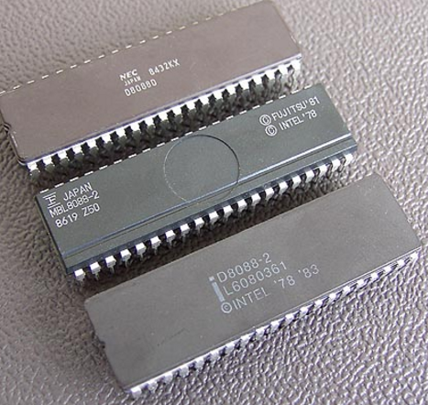
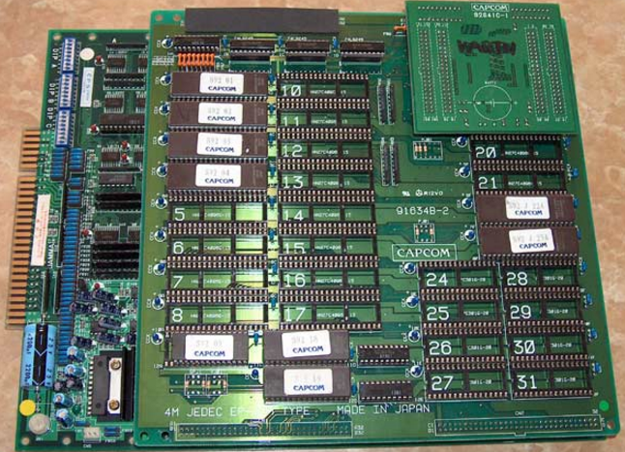
History of microprocessor (Continue)
The 8088 Microprocessor(32 bit):
Although the 8086 was a great chip, it was expensive at the time and more importantly required expensive 16-bit board designs. To help bring costs down, in 1979 Intel released what some called a crippled version of the 8086 called the 8088.
Performance:
The 8088 processor used the same internal core as the 8086, had the same 16-bit registers, and could address the same 1MB of memory, but the external data bus was reduced to 8 bits. These reasons are why IBM chose the 8088 instead of the 8086 for the first PC.
Intel's 32-bit architecture dates to 1985 and it took a full 10 years for 32-bit mainstream OS (Windows 95) and another 6 years for the mainstream to shift to a fully 32-bit environment for the OS and drivers (Windows XP).
That is why 16 years is a lifetime in technology.

Slide 10
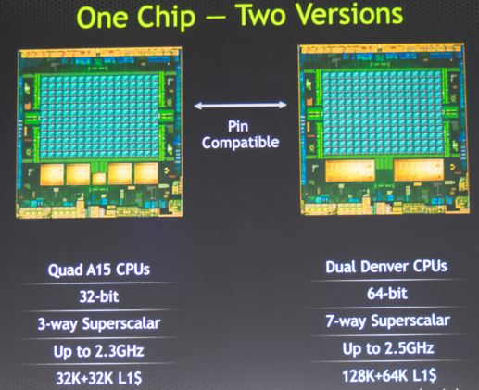
History of microprocessor (Continue)
The Microprocessor(64 bit):
Now we are in the midst of another major architectural jump moving from 32-bit to 64-bit. IA-64 was first announced in 1994 as a CPU development project with Intel and HP. The first technical details were made available in October 1997. The result was the IA-64 architecture and Itanium chip, which was officially released in 2001.
The fact that the IA-64 was made for non-PC environments such as servers. That is why Intel eventually released its own set of 64-bit extensions, which it calls EM64T or IA-32e mode.
To make 64-bit computing a reality, Microsoft began providing trial versions of Windows XP Professional x64 Edition (which supports AMD64 and EM64T) in April 2005.
The 64-bit microprocessor address space allows the processor to work with 2^64 of physical memory.
It can address only 1 Tbyte (2^40) of memory.

Slide 11
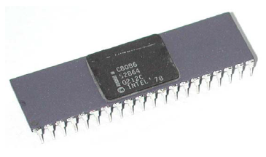
Main components of microprocessor
The hardware architecture of 8086 and 8088 processors:
The microprocessors 8086 and 8088 were both made of HMOS technology with an IC circuitry equivalent to ≈ 29000 transistors. (HMOS: high performance metal oxide semiconductor).
Unlike the software model, the hardware architecture of 8088 microprocessor is different from that of 8086.
Both processors are housed in a 40-pin dual in-line package, with many of the pins having multiple fictions or Multiplexed.

Slide 12
Main components of microprocessor (cont.)
The Modes of Operation:
- The microprocessors 8086 and 8088 can be configured to work in two modes: The Minimum mode and the Maximum mode.
- The Minimum mode is used for single processor system, where 8086/8088 directly generates all the necessary control signals.
- The Maximum mode is designed for multiprocessor systems, where an additional “Bus-controller” IC is required to generate the control signals. The processors control the Bus-controller using status-code.

Slide 13
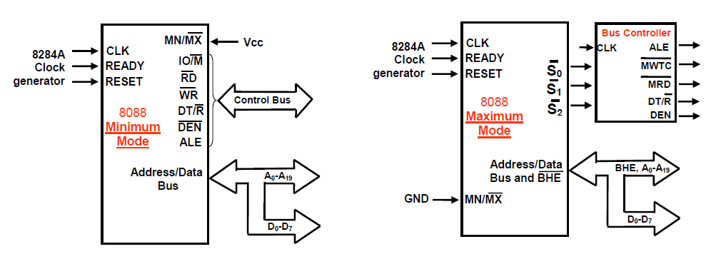
Main components of microprocessor (cont.)
Figure: The Modes of Operation:

Slide 14
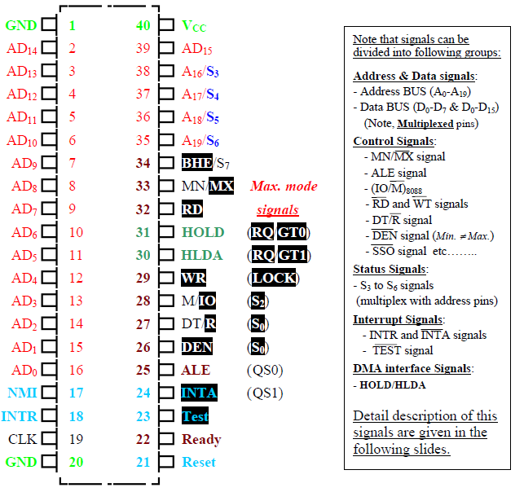
Main components of microprocessor (cont.)
Figure : The Pin-configuration of 8086 Microprocessor IC

Slide 15
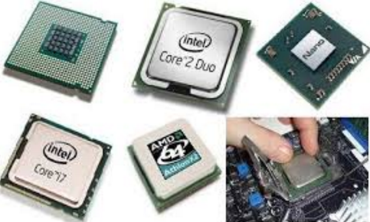
Knowledge one must have
To build a microprocessor a person must know about digital logic design, CMOS, NMOS, PMOS, transistor, logic gates, designing capability, analytic capability, etc.

Slide 16
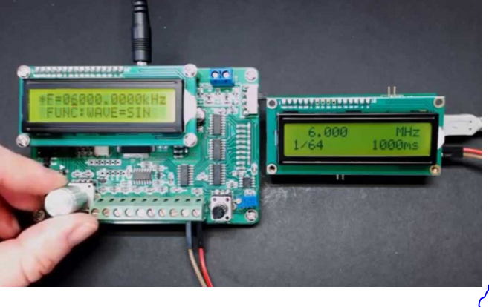
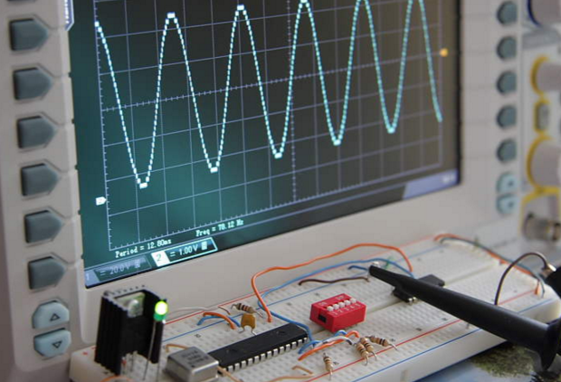
Applications of Microprocessors
Microprocessors are a mass storage device. The availability of low cost, low power and small weight, computing capability makes it useful in different applications.
Now a days, a microprocessor based systems are used in instructions, automatic testing product, speed control of motors, traffic light control , light control of furnaces etc. Some of the important areas are mentioned below:
Instrumentation:
It is very useful in the field of instrumentation.
Frequency Counters
Function generators
Fig: Frequency Counters
Fig: Function generators

Slide 17
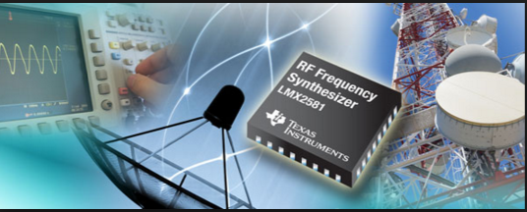
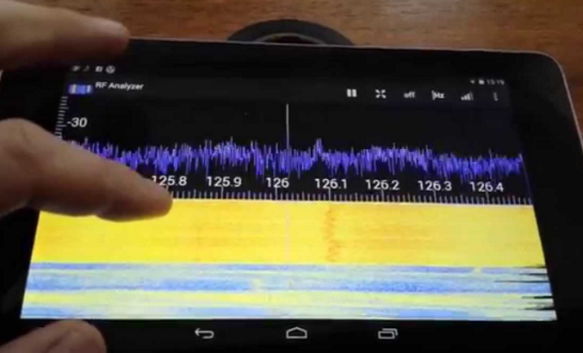
Applications of Microprocessors(cont.)
Frequency synthesizers
Spectrum analyses
Figure: Frequency synthesizers
Figure: Spectrum analyses

Slide 18
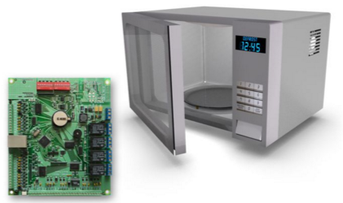
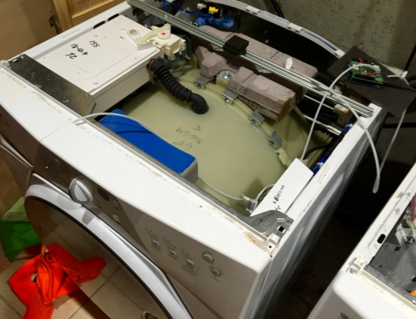
Applications of Microprocessors(cont.)
Control:
Microprocessor based controllers are available in home appliances.
Such as:
Microwave oven
Washing machine
Figure: Microwave oven
Figure: Washing Machine

Slide 19
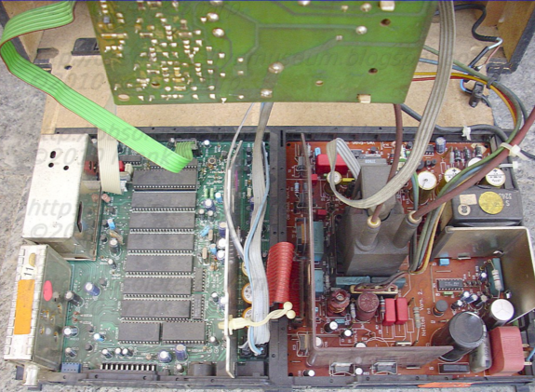
Applications of Microprocessors(cont.)
Communication:
Microprocessors are being used in a wide range of communication equipment's.
In television
and so on……………...

Slide 20
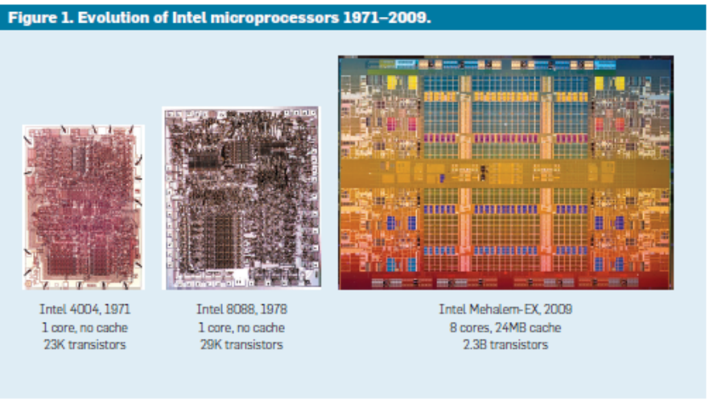
Future prospect of Microprocessors
In past 20 years, microprocessors performances has grown rapidly, following Moore’s Law

Slide 21
Future prospect of Microprocessors (Cont.)
• Three key technology driver:
1. Transistor speed scaling
2. Core micro architectures techniques
3. Cache memory techniques
Transistor speed scaling
• MOS transistor: workhorse for decades
• Scaling performance by 5 orders of magnitude.
Cache memory techniques
1. DRAM has also advanced dramatically… But it’s too slow
2. Memory organization is optimized for density and lower cost
3. Use of small and fast caches on microprocessor die
4. Energy became a concern: increasing cache size for performances has proven more energy efficient than additional micro architectures techniques.
Core micro architecture techniques
1. Advanced micro architectures provided lots of techniques to increase performances
2. Performance increase empirically described by Pollack’s Rule:
Performance increase (when not limited by other parts of the system) as the square root of the number of transistor or area of a processor

Slide 22
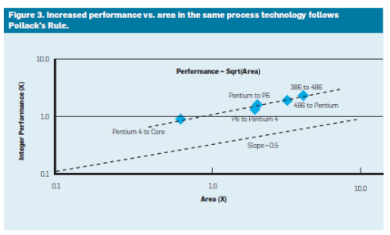
Future prospect of Microprocessors (Cont.)
Figure: Increased performance vs. area In the same process technology follows Pllack’s Rule.

Slide 23

Thanks to all!

